Slide 1

Victorian Britain
Liberty Classroom, History of England, Lecture #11

Slide 2
Chronology of Victorian Britain
Key moments in Victorian history
1832
Great Reform Bill
1833
Slavery Abolition Act
1851
Great Exhibition
1857
Indian Rebellion
1888
Jack the Ripper

Slide 3

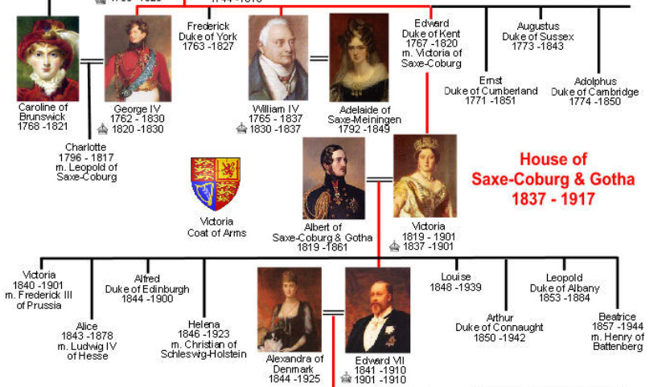
Hanover ➔ Saxe-Coburg & Gotha
George IV (1820-1830)
William IV (1830-1837)
Victoria (1837-1901)
Edward VII (1901-1910)

Slide 4
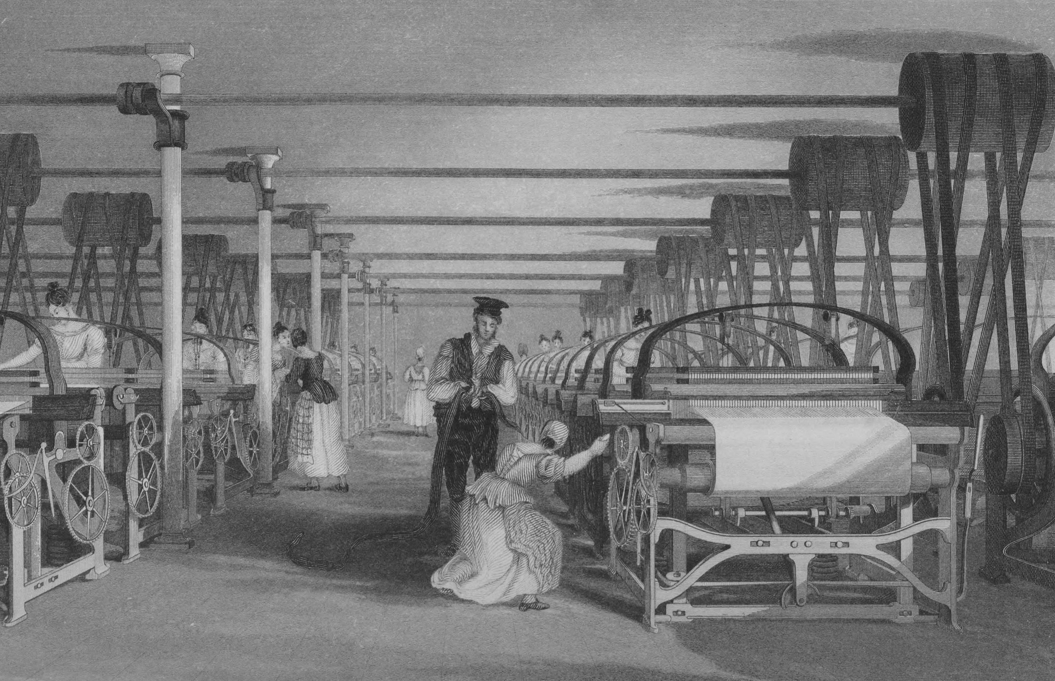
Industrial Revolution
Mass production for mass consumption
Putting-out system ➔ factory system
Urbanization
Transportation networks
Symbolism of Great Exhibition

Slide 5
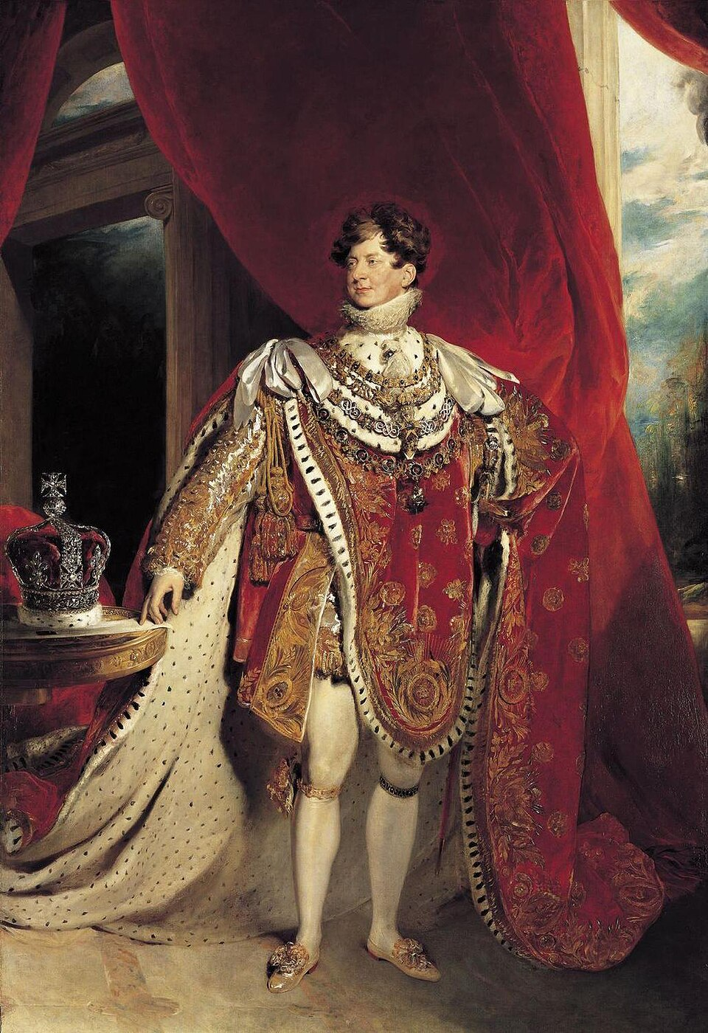
Regency ➔ Victoria
Regency (1811-1820) and Lord Liverpool
George IV (1820-1830)
  Buckingham Palace & Windsor Castle
  Roman Catholic Relief Act (1829)
William IV (1830-1837)
  Dorothea Jordan & Princess Adelaide
  Split the Britain-Hanover succession

Slide 6
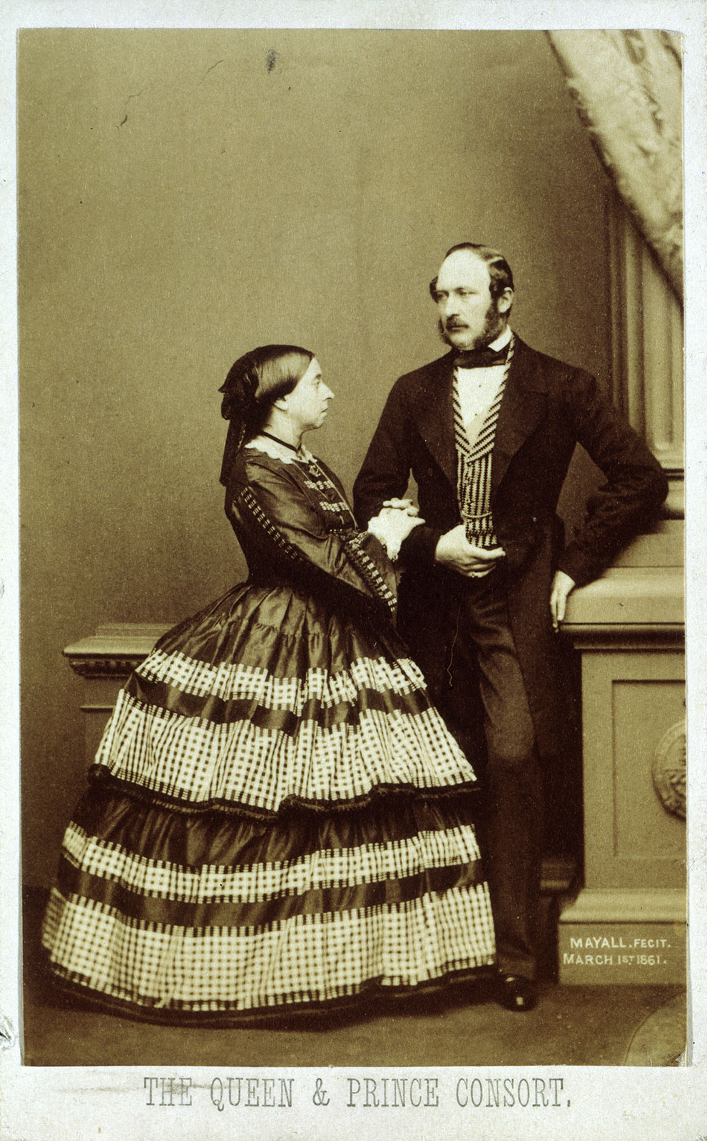
Victoria & Albert
Marriage in 1840
British resistance to Albert
  Initial freezing out of government
  Privy Councilor and designated regent
  Prince Consort (1857)
Albert’s death in 1861 devastated Victoria

Slide 7
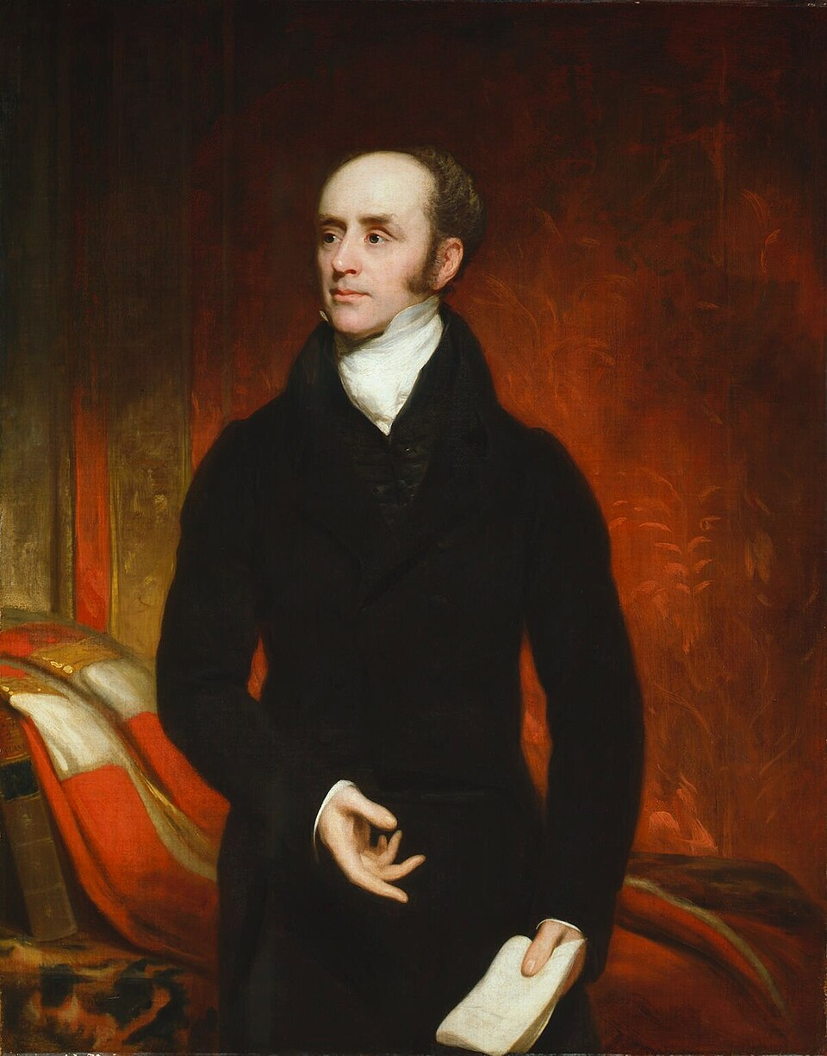
Parliamentary Reform
18th-century “Rotten Boroughs”
Great Reform Bill (1832)
Chartist movement
Further suffrage extensions
  1867
  1884

Slide 8
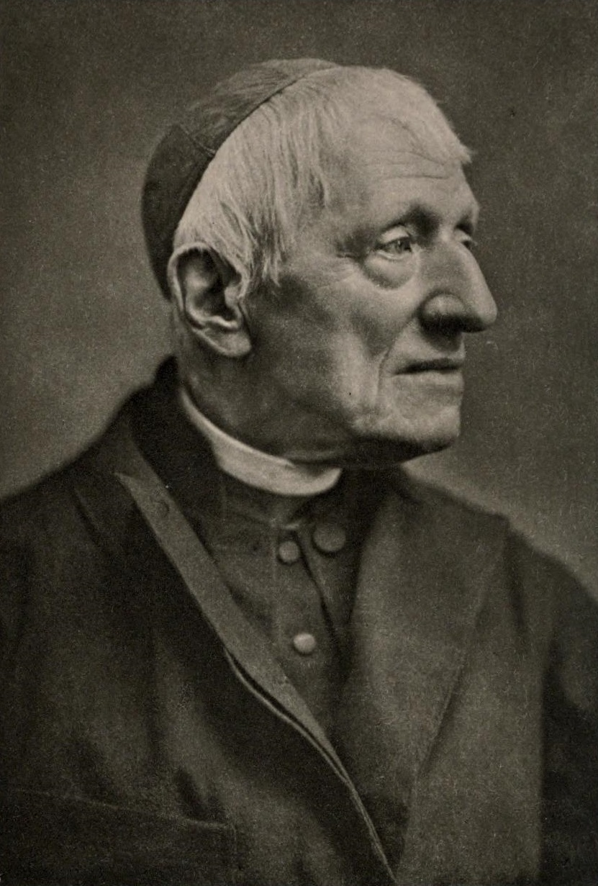
Religious Reform
Pros and Cons of Establishment
Evangelical movement
  Methodists and Dissenters
  Sunday Schools
“Feminization” & alienation of working-class men
Salvation Army (1878)
Oxford Movement & John Henry Newman

Slide 9

British Empire
Opium Wars (1839-1842)
Irish Potato Famine (1845-1855)
Indian Rebellion (1857)
Ottoman Protectorate
Scramble for Africa (1880s-1910)

Slide 10
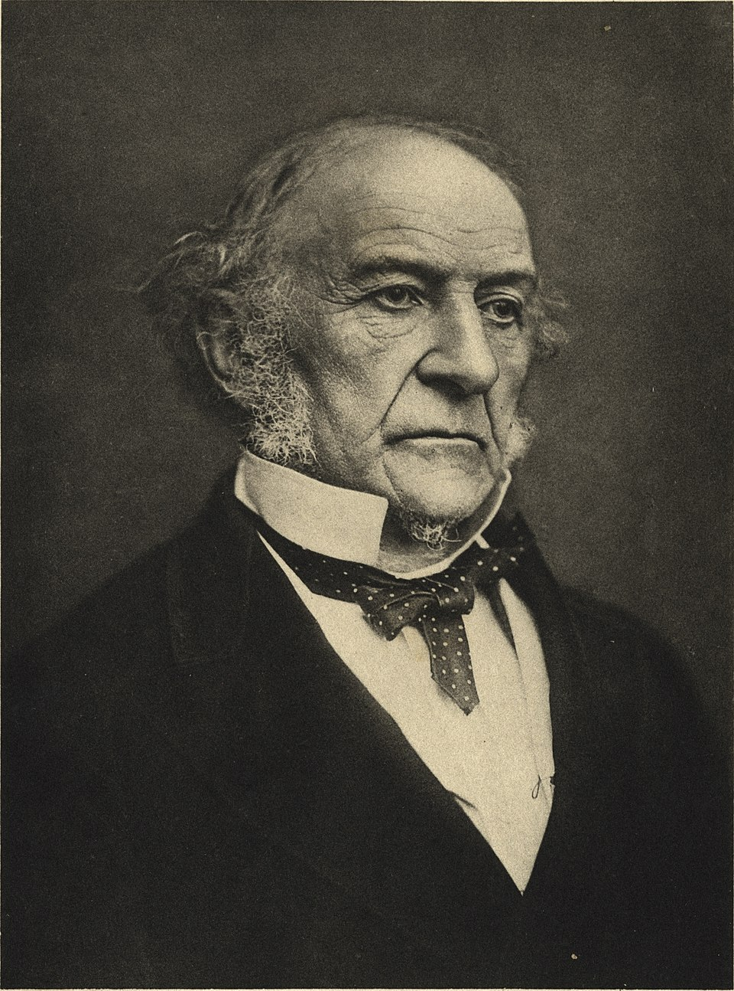
Disraeli & Gladstone
Benjamin Disraeli (1804-1881)
  Ministries: 1868; 1874-1880
William Gladstone (1809-1898)
  Ministries: 1868-1874 “Great Ministry”; 1880-1885; 1886; 1892-1894
Issues: Empire, Education, Irish Home Rule

