Slide 1

Edwardian Britain & the World Wars
Liberty Classroom, History of England, Lecture #12

Slide 2
Chronology of British Foreign Policy
Key moments in British foreign policy
1815
Battle of Waterloo
1851
Crimean War Begins
1878
Congress of Berlin
1914
Beginning of World War I
1939
Beginning of World War II

Slide 3

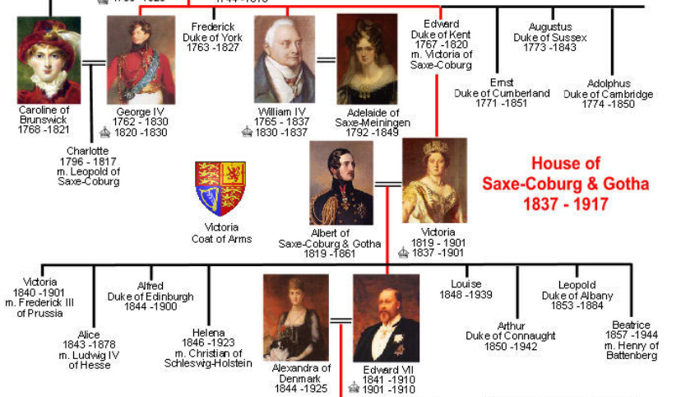
Hanover ➔ Saxe-Coburg & Gotha
George IV (1820-1830)
William IV (1830-1837)
Victoria (1837-1901)
Edward VII (1901-1910)

Slide 4
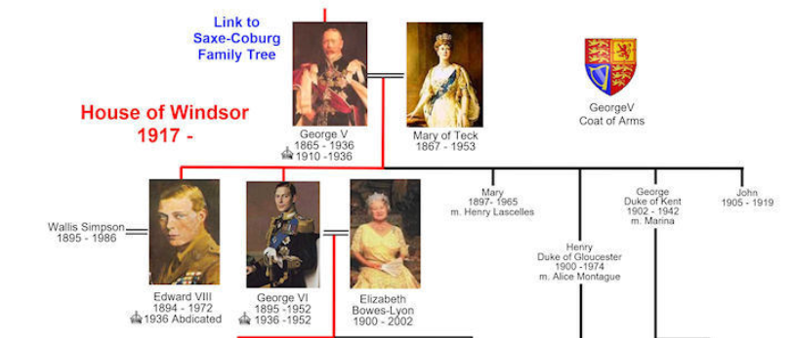
House of Windsor
George V (1910-1936)
Edward VIII (1936)
George VI (1936-1952)

Slide 5
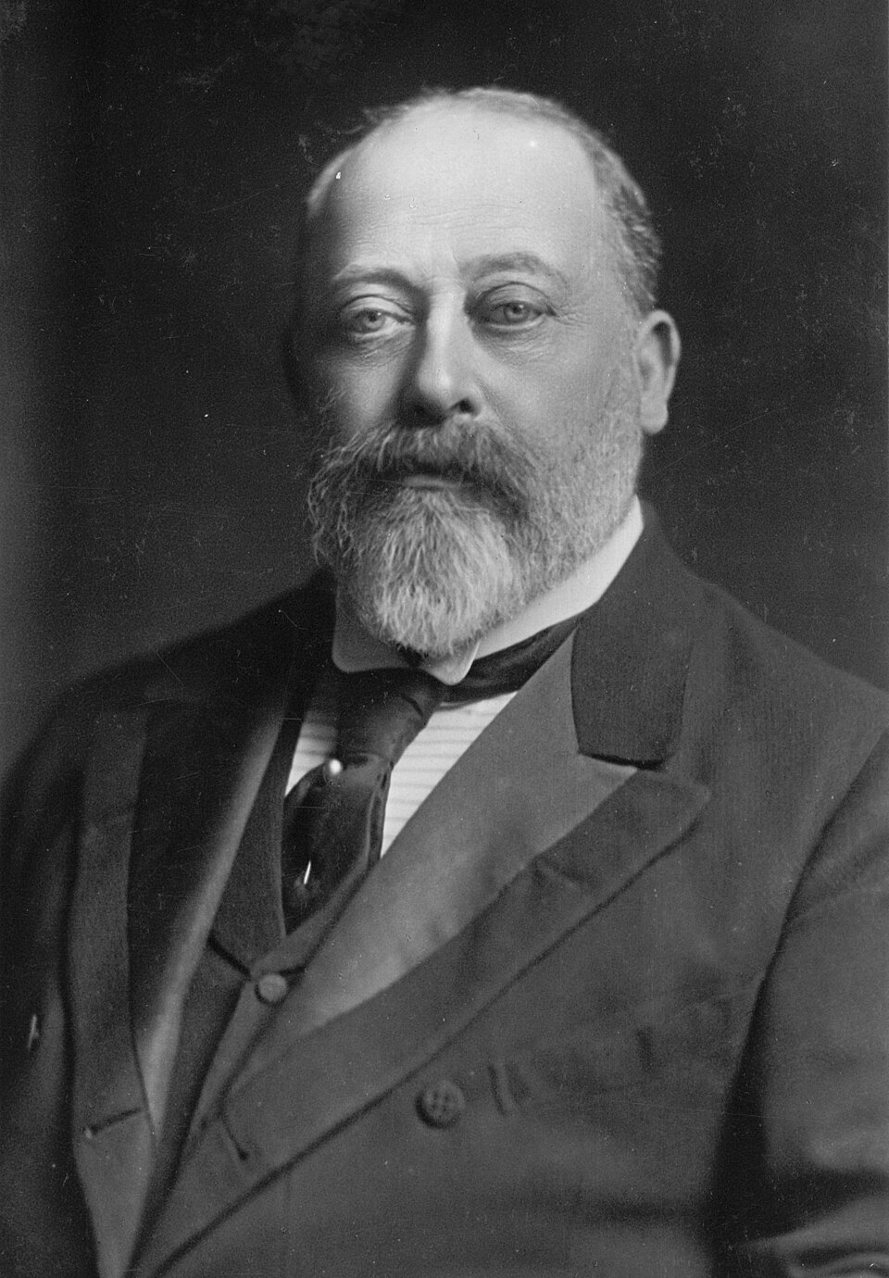
Edward VII (1901-1910)
Strained relationship with Victoria and exclusion from politics
Reputation as playboy, arbiter of fashion
Worked to modernize military after Boer War
“Uncle of Europe,” but disliked Wilhelm II

Slide 6
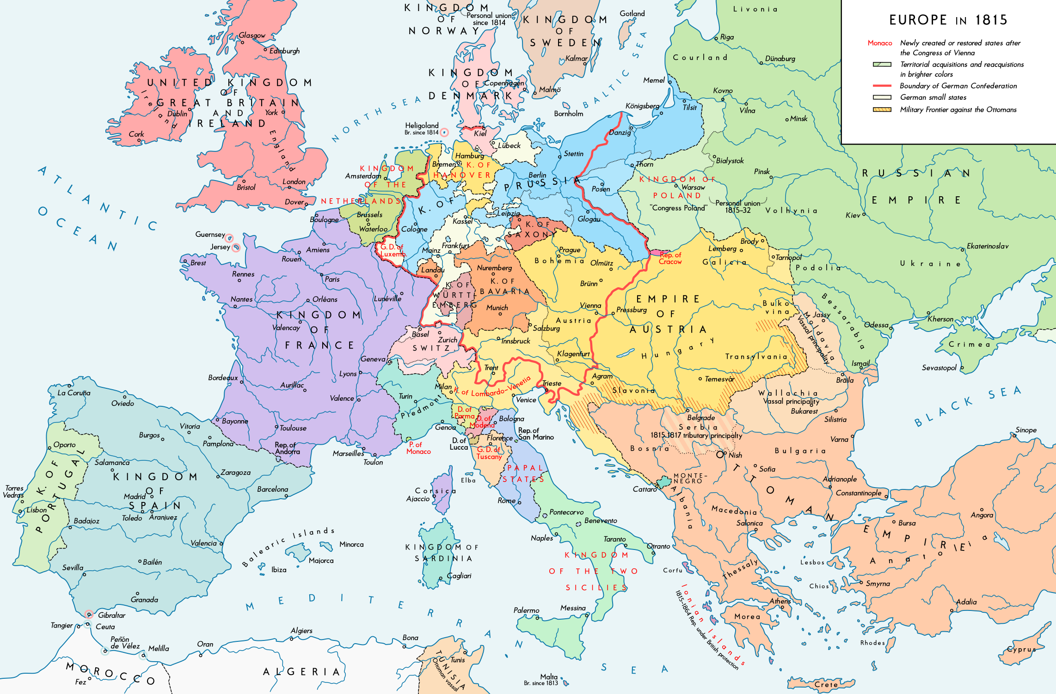
Splendid Isolation
Balance of Power
Napoleonic Wars and Waterloo (1815)
Quadruple Alliance ➔ Concert of Europe
Rivalry with Russia
Crimean War (1853-1856)
Congress of Berlin (1878)

Slide 7
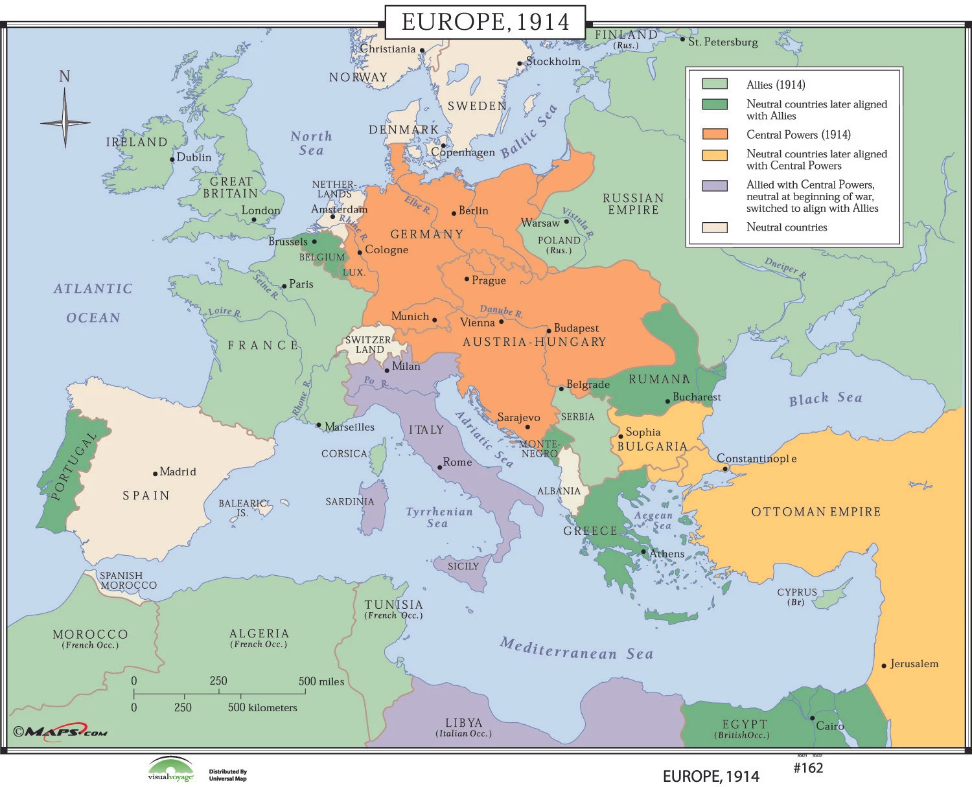
Road to World War I
Antagonism with Germany
Response to Triple Alliance
Entente Cordiale (1904)
Moroccan Crises (1905, 1911)
Anglo-Russian Entente (1907)
Guarantor of Belgian neutrality? (Treaty of London, 1839)

Slide 8
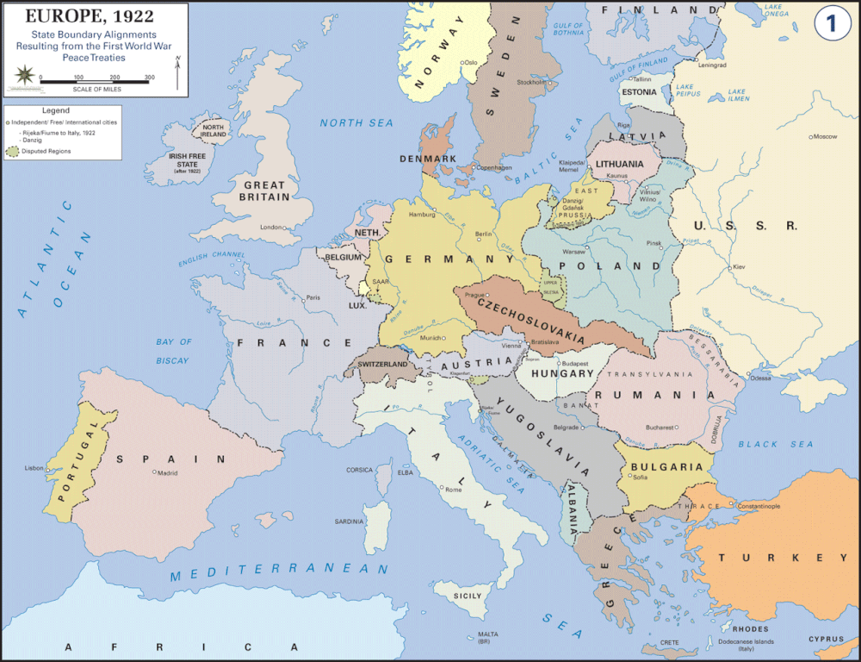
Interwar Period
Exhaustion following WWI
Paper expansion of Empire
German reparations ➔ British debt payments
Abortive return to gold standard
Security guarantees to new states in Central Europe

Slide 9
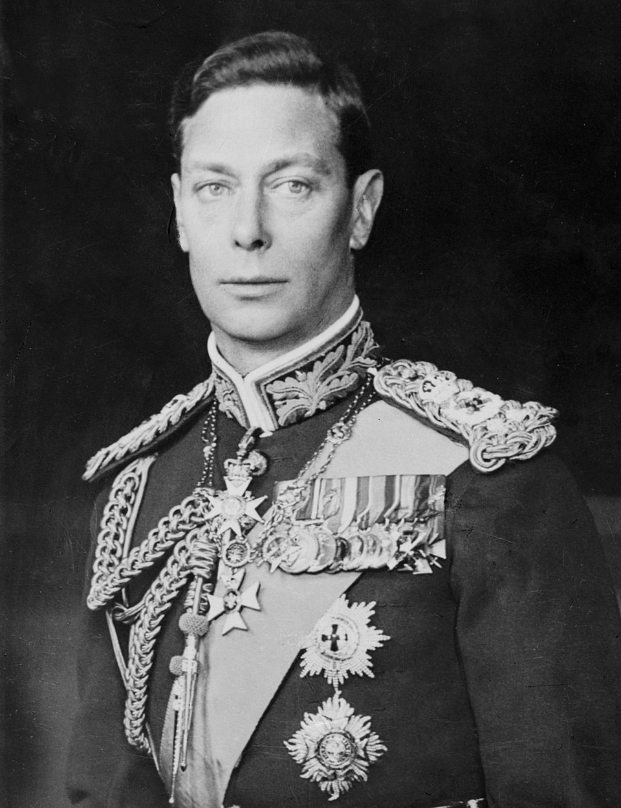
House of Windsor
George V (1910-1936)
Parliament Act of 1911
First Royal Christmas speech (1932)
Edward VIII (1936) and Wallis Simpson
George VI (1936-1952)
Speech impediment
Association w/Chamberlain

Slide 10
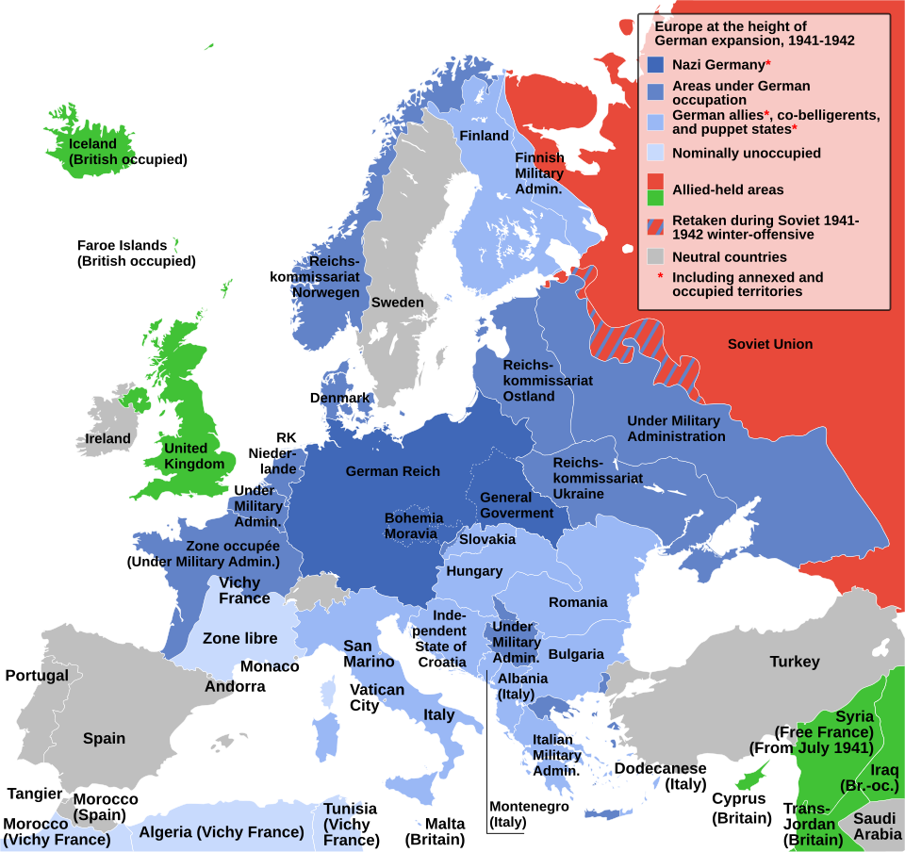
Britain and WWII
1930s appeasement of Germany
Declaration of War (September 1939)
Phony War
Evacuation at Dunkirk
The Blitz

